Slide 1
EU Migrants’ Experiences of Hate Crime Post-Brexit Vote
Dr Karen Lumsden
k.lumsden@lboro.ac.uk
@karenlumsden2

Slide 2
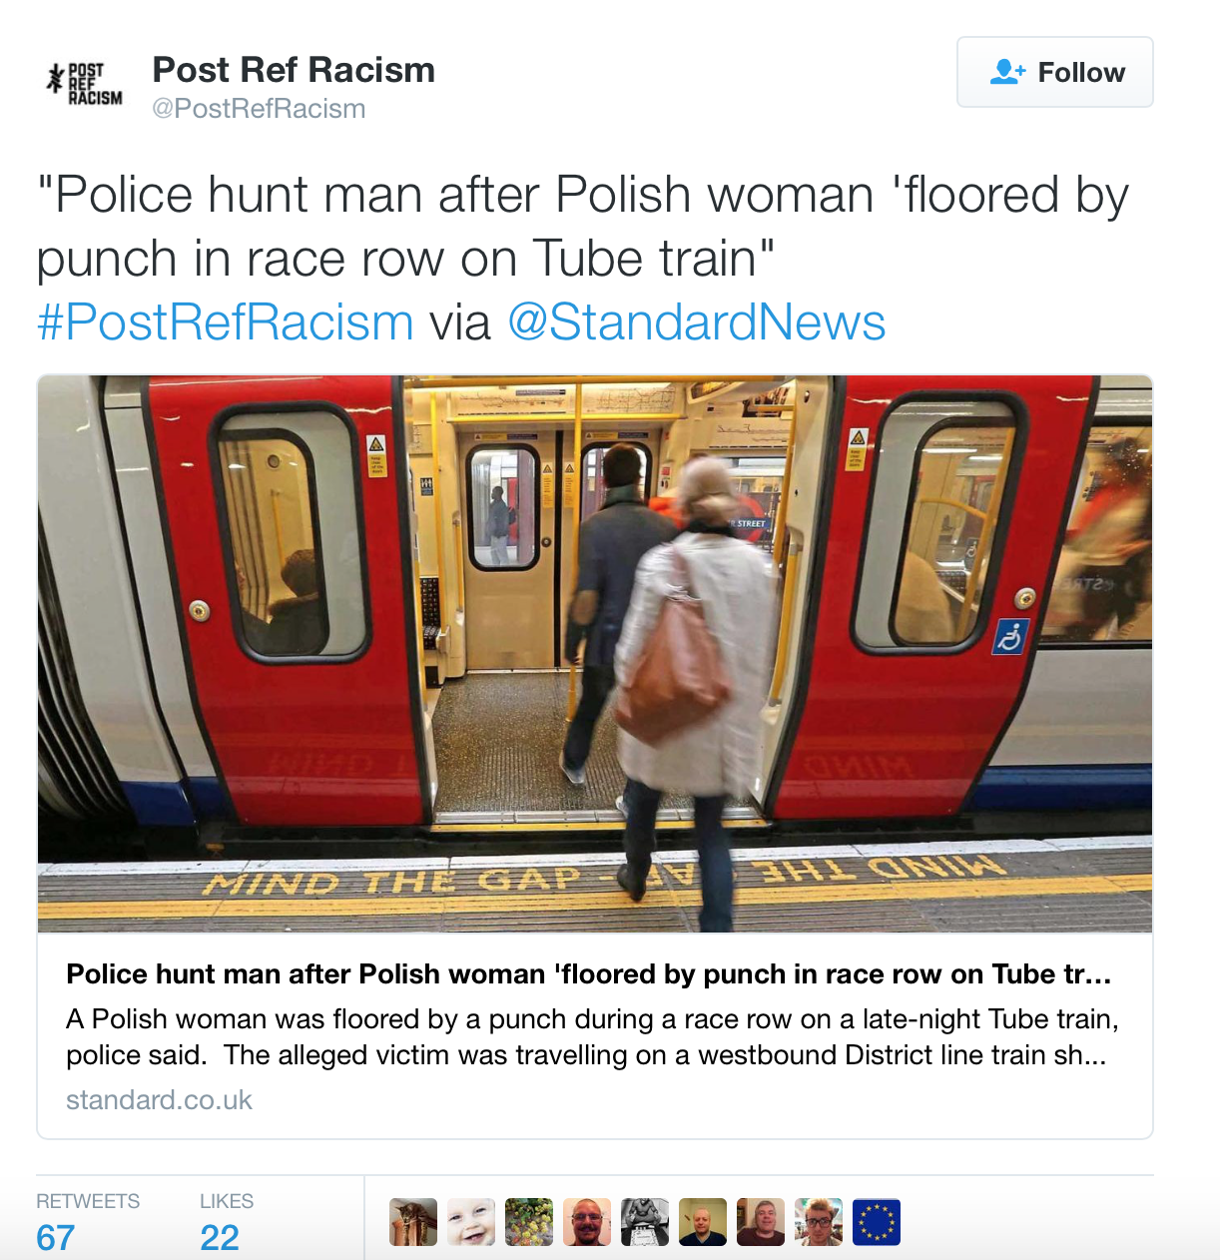
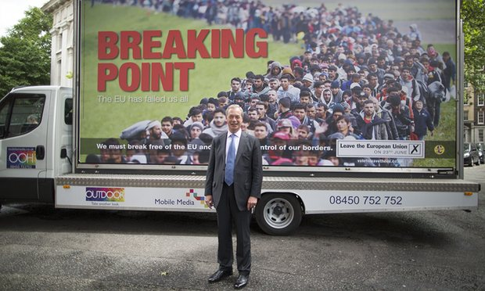
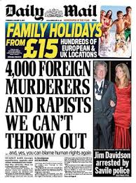
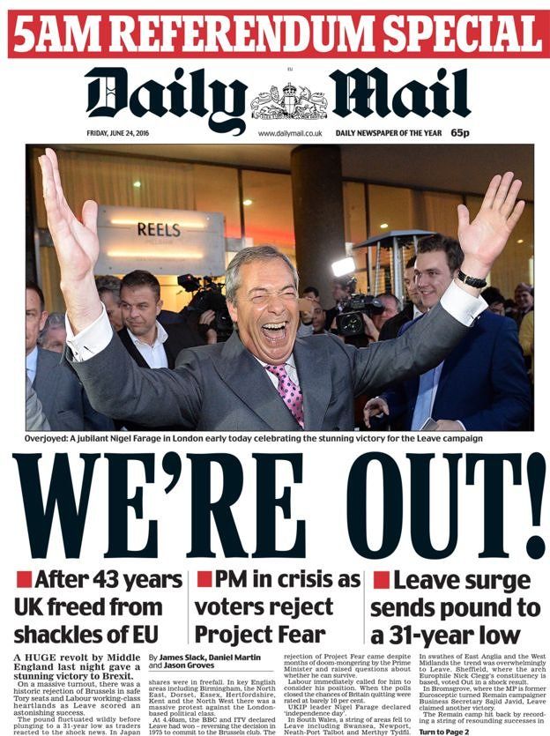
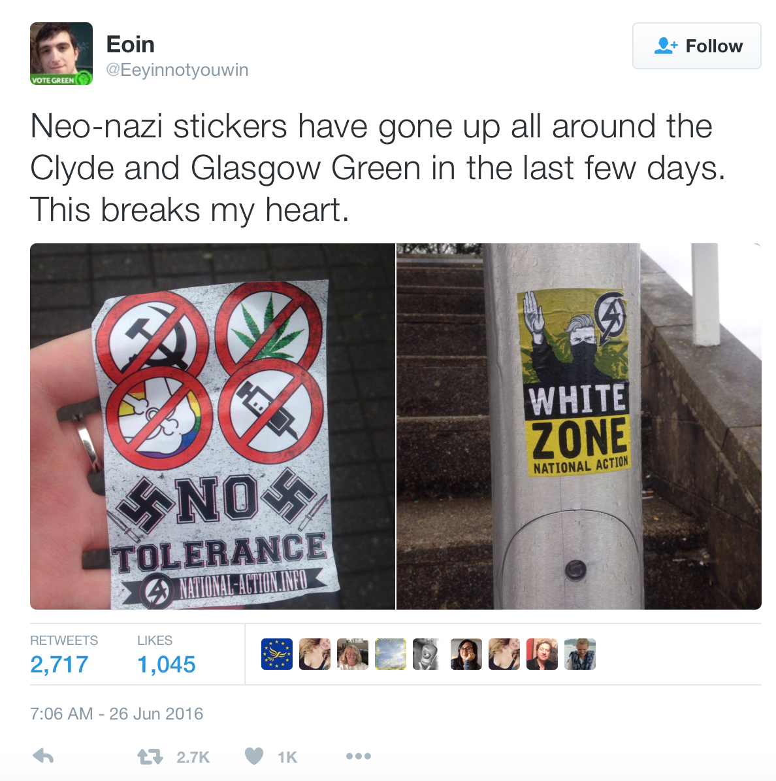
Introduction
Notes:
Presentation focuses on EU migrants’ experiences of hate crime in Linconshire, East Midlands, in the wake of the brexit referendum and leave vote.
Project in preliminary findings stage, and data presented is based on qualitative semi-structured interviews conducted with migrants. Project is one of 4 funded projects undertaken for the East Midlands Policing Academic Collaboration (EMPAC) Vicitms Network.
Format of the presentation:
Brief background to brexit vote.
Immigration and demographics of East Midlands, and Boston Lincolnshire.
Background to the study and methods.
Hate crime literature.
Then present initial findings which focus on (depending on time available):
Changes in attitudes towards migrants pre-recession and post-brexit.
Experiences of hate crime.
Identity and markers of difference.
Normalization of racism.
Impact of the ‘leave’ vote.

Slide 3
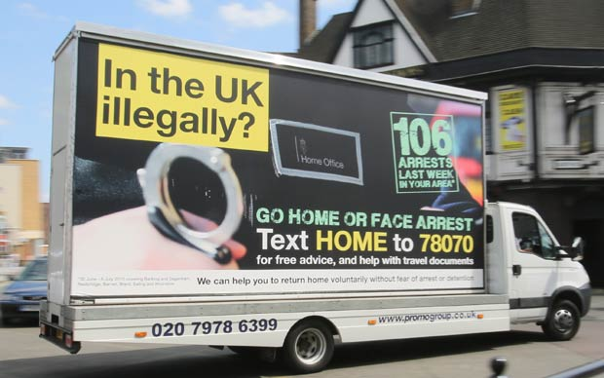
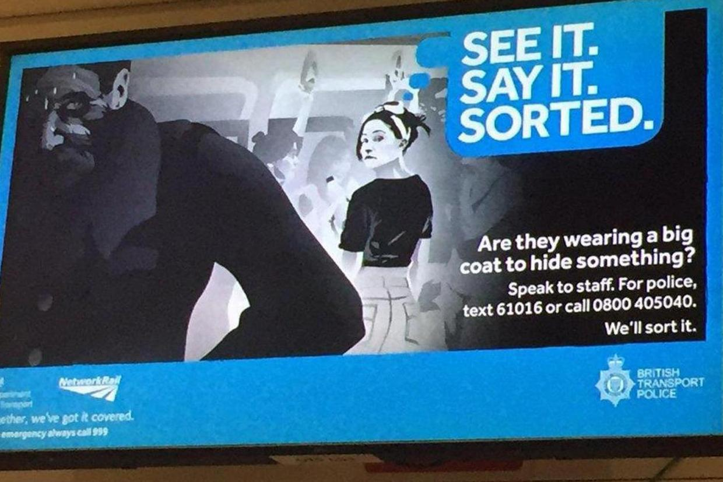
Hate Crime Post-Brexit Vote
Hate speech and hate crimes against migrant populations increased leading up to, and in the wake of, ‘brexit’ referendum (Lyons 2016).
Second half of June, when the vote took place, 3,219 hate crimes were reported to police (37% increase compared to the same period in 2015) (Ramadan 2016)
Scope of racist hate crime has changed to include the targeting of asylum seekers, migrant workers, and foreign nationals.
Environment of ‘intolerance’ has been cultivated by UK politicians (i.e. Home Office ‘Go Home Van’ and BTP posters).
‘Denials of prejudice’ - ‘discoursive deracialisation ’ describes the strategy by which politicians avoid using racial categories:
‘Acts of Parliament, designed to restrict immigration of non-whites, are phrased in such a way that race is never mentioned. Other criteria are used, and it is, as if by magic, that these ‘fairminded ’ criteria result in the exclusion of non-whites’ (Billig 2012: 136).
Notes:
In the context of austerity, anti-immigration sentiment in England has increased alongside expansion of EU via accession of new member states (Burnett 2013).
In 2004 the UK opened its doors to migrants from the EU’s eight new member states from East Europe. In 2007, migrants from Romania and Bulgaria, the EU’s next members, were also granted entry.
For the purposes of this paper: ‘‘Race’ in this sense is not an essential trait of migrants, but rather the socially constructed contingent outcome of processes and practices of exclusion. It is the valorized language through which structured inequalities (measured in labour market position, differential access to scarce resources, legal status, and cultural stereotypes) are expressed, maintained, and reproduced. Racialization does not require putative phenotypical or biological difference; it can also make use of (and/or construct) cultural traits as a basis of differentiation’ (Fox et al. 2012: 681).

Slide 4
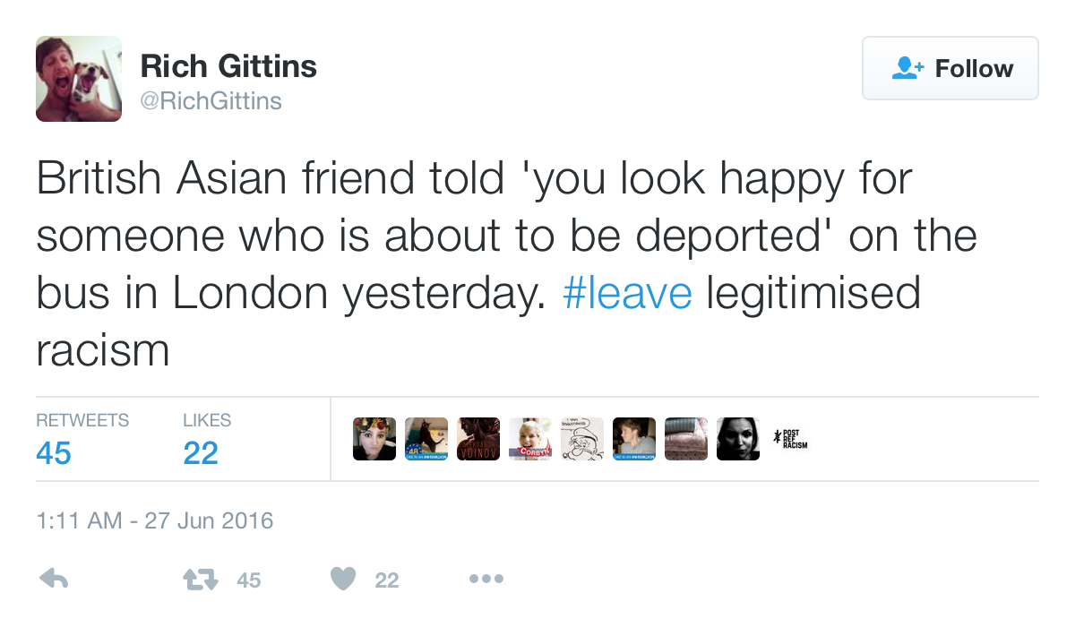
PRRX Abuse Reported via Social Media (Komaromi and Singh 2016)
Analysis of reports of hate crime to three social media platforms: PostRefRacism, WorryingSigns, and iStreetWatch.
PRRX abuse targeted anyone perceived to be ‘foreign’ and was anti-immigrant rather than anti-European in its rhetoric.
Large proportion of abuse reported specifically referred to the referendum.
Themes are placed within the context of an increasing normalisation of xeno-racist narratives and the manifestation of the ‘hostile environment principle’.
Opportunities and challenges presented by social media activism as a force for affecting positive change and challenging xeno-racist narratives.
Notes:
Social media has been an important tool for the reporting of abuse and also of collective responses to these forms of hate crime.
However, conversely it has also provided an outlet for hate crime.

Slide 5
Study Aims
One of four projects conducted as part of the East Midlands Policing Academic Collaboration (EMPAC) Victims, Witnesses & Public Protection Network.
Funded via HEFCE and the College of Policing, ‘Policing Knowledge Fund’.
Explores:
EU migrants’ experiences of hate crime in Lincolnshire, England, pre and post-Brexit vote.
Experiences in online and offline spaces and the boundaries and intersections within / between these spaces.
How victims manage and negotiate their way through these spaces.
How the brexit vote has impacted on experiences and perceptions of hate crime.
Barriers and facilitators to the reporting of hate crime to the police.
Current support and provisions available to victims of hate crime in Lincolnshire.

Slide 6
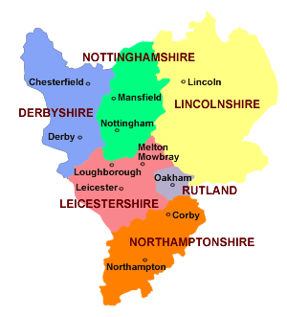
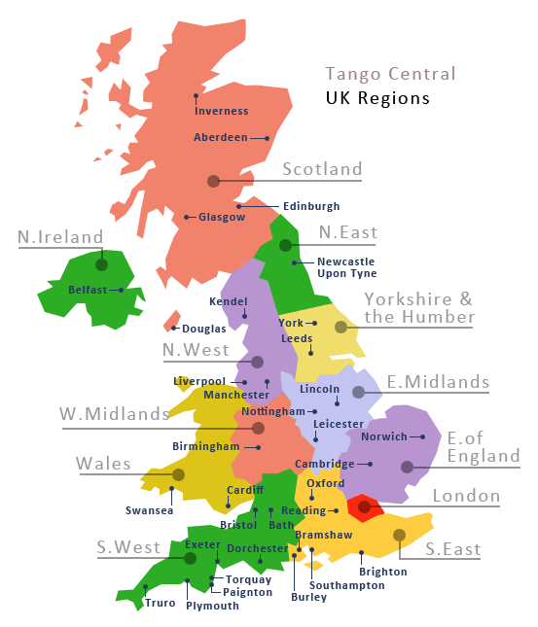
East Midlands

Slide 7
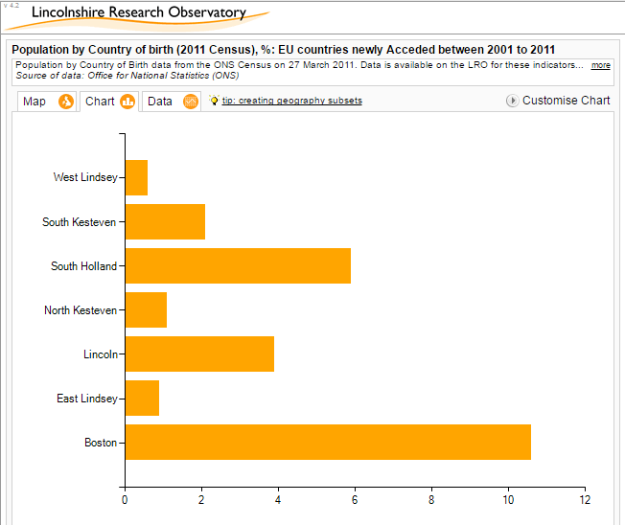
Migration in the East Midlands
Migration Observatory, 2013
EM smaller than average proportion of migrants, but 77% increase since 2001
Polish most commonly spoken language by non English or Welsh speakers
Boston has seen a 467% increase in its migrant population in a decade – biggest of anywhere in England and Wales
South Holland third biggest by 224.6%
http://edition.cnn.com/videos/business/2016/06/15/boston-england-brexit-vote-dnt-quest.cnn
Notes:
Lincolnshire has about 3% population of people from EU countries acceeded to the UK between 2001-2011.
The England average is 2.4%.
Boston is 10.6%.
According to the 2011 Census, Boston is now home to a higher proportion of eastern European immigrants than anywhere else in England and Wales: 10.6 per cent of the town’s population of 65,000 comes from one of the “new” EU countries such as Poland, Lithuania, Latvia or Romania.
South Holland has seen the third-biggest proportional increase, at 224.6%.
[Remember to play video which focuses on attitudes to the vote and immigration before the referendum].

Slide 8
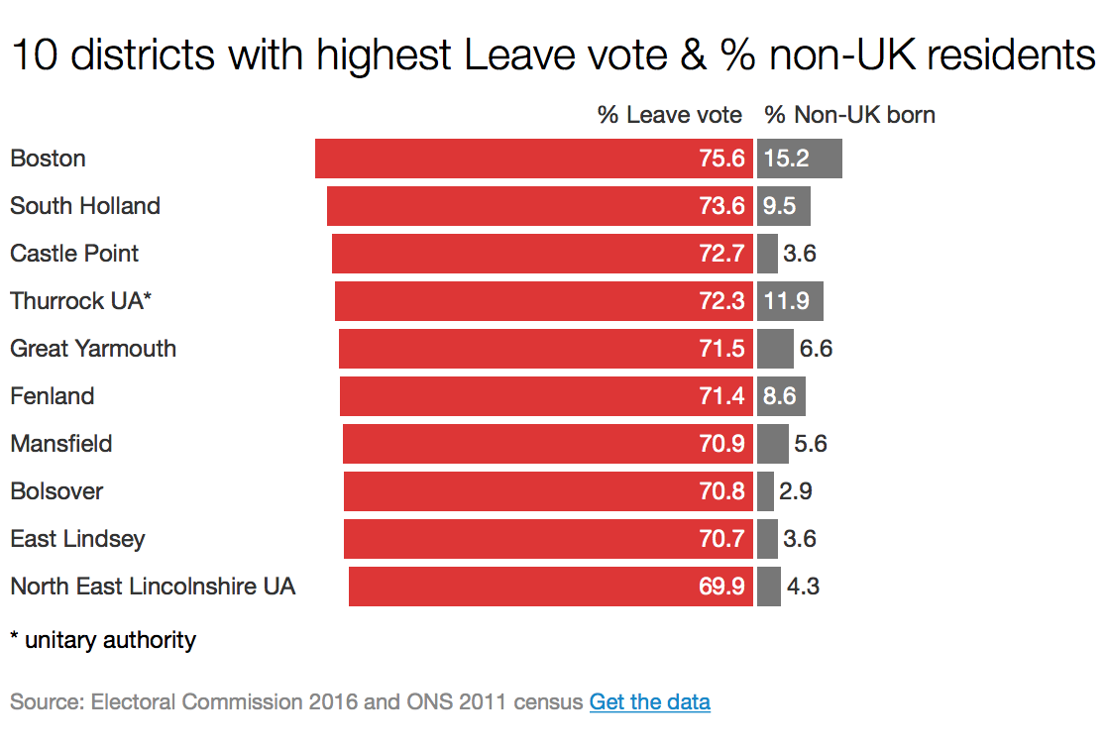
Anti-immigration Sentiment and the ‘Leave’ Vote
Residents most likely to oppose immigration have the least direct experience of it.
Contact and assimilation should lessen anti-immigration sentiment.
Same experience during Brexit.
Except for Boston as an outlier.
Boston is the most segregated place in the UK (Policy Exchange 2016).
10.6% of the town's population of 65,000 comes from new EU countries such as Poland, Lithuania, Latvia or Romania (Policy Exchange 2016).
Notes:
Previous research has shown that those areas with the least direct experience of immigration tend to have the highest anti-immigration sentiment. Idea is that areas who experience immigration tend to assimilate together and thus real lived experience reduces anti-immigration feeling.
This outcome was also demonstrated with the Brexit vote, with the areas of highest migration having the lowest leave vote and vice versa, except for Boston which is an example of an outlier.
Residents born outside the UK accounted for 15.2% of the population, above the national average, while 75.6% voted to leave (Lawton and Ackrill, 2016).

Slide 9
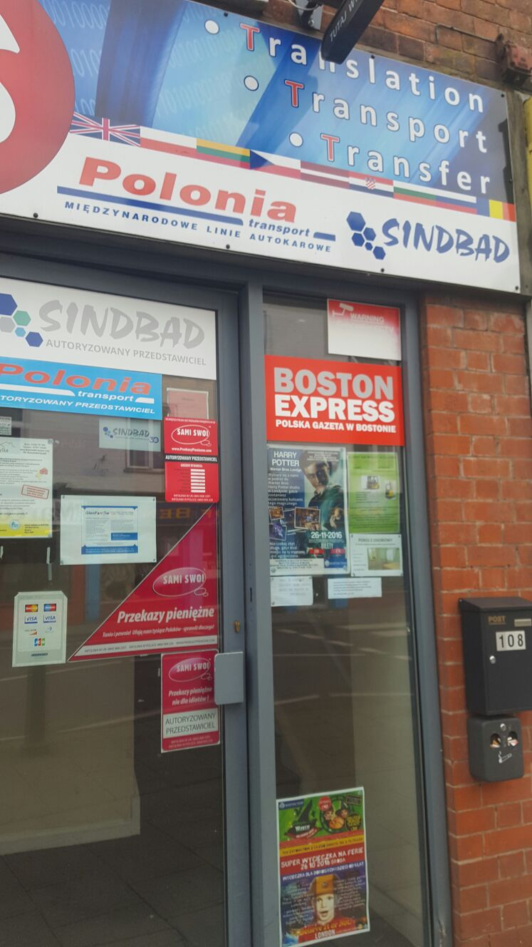
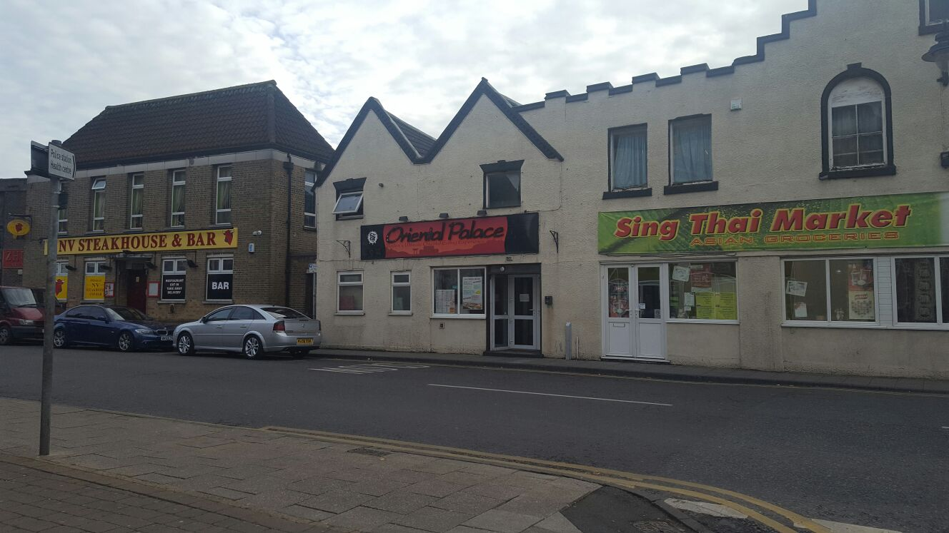
Boston, Lincolnshire
Particularly significant area as it recorded the highest leave vote in the 2016 Brexit referendum
Over 75% of voters in the town of Boston voting to leave (BBC 2016).
Boston is home to the highest concentration of EU migrants after London (Chakelian 2016).
Migrant employment in factories and agriculture
‘Little Poland’, West Street, Boston
(Source: author’s own)

Slide 10
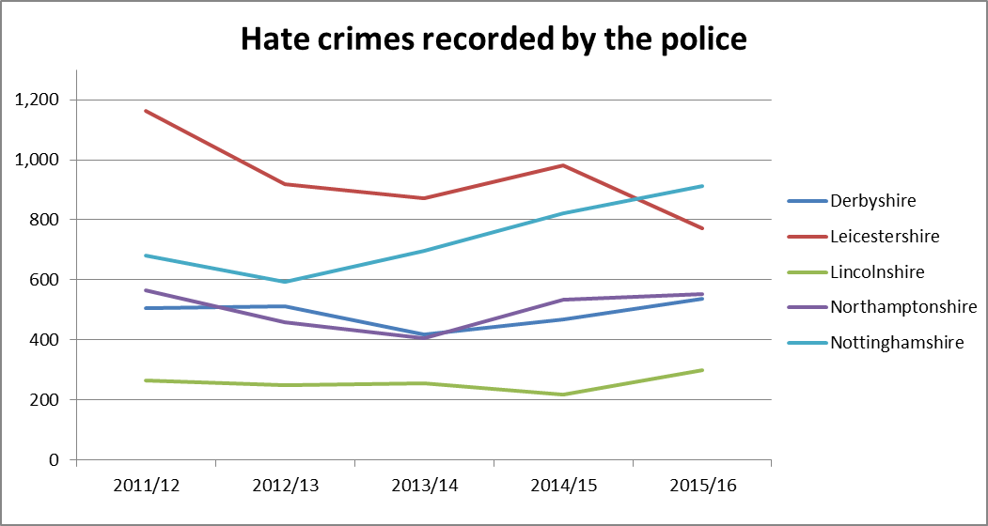
Hate Crime Recorded by the Police in the East Midlands 2011-2016
Source: Home Office (2016)
Notes:
Hate crime in Lincolnshire has been fairly consistent over the past 5 years, approx 10% of all EM hate crime. Possible increase in the past year.
Increase just before and just after brexit, particularly amongst migrant population. But beware still small numbers.
And as always – wary of police recorded crimes as the findings thus far demonstrate that victims interviewed are not likely to report incidents to the police.
Contextualize the project further here. What are we doing and why.

Slide 11
Methods
Qualitative semi-structured interviews with EU migrants residing in Lincoln or Boston.
Access via a local hate crime police officer and community groups (purposive and snowball sampling).
Thematic analysis of data.
EU migrants from countries including Poland, Czech Republic and Hungary.

Slide 12
Hate Crime Studies
Concept of hate crime now widely utilised with proliferation of hate crime studies from 1980s / 1990s onwards
Prejudice associated with the victim’s ‘minority status’ (or perceived status) i.e. race, ethnicity, sexuality, colour, religion, gender and disability (Mason 2005)
For Perry (2001: 46) racist hate crime can be explained by a perspective she calls ‘doing difference’.
‘…hegemony of difference is institutionalised through unequal relations in, amongst others, the sphere of employment, where race discrimination may occur, and the cultural sphere, where the media may depict minority ethnic groups as the dangerous “criminal other”’ (Wolhuter et al. 2008: 87).
However power relations are more complex and fragmented in post-structuralist society (Hopkins Burke and Pollock 2004).
For Hall (2005) a variety of factors (i.e. psychological and contextual) help explain hate crime:
I.e. localised strains such as unemployment and housing shortages
Racist hate crime is not an individual phenomenon – offender attitudes rooted in community values
Recent debates concerning the definition of hate speech, and the relevance of perceived vulnerability and ‘difference’ (Chakraborti and Garland 2014; Garland 2010).
Research on perpetrators of hate crime – not always strangers to victims (Mason 2005).

Slide 13
Initial Findings – Today Focus On:
Changes in attitudes towards migrants
Experiences of hate crime
Identity and markers of difference
Normalization of racism
Impact of the ‘leave’ vote

Slide 14
1. Changes in Attitudes Towards Migrants

Slide 15
Change in Attitudes Post-Recession
“I was quite lucky that I came across really kind people. But there were always … some, in 2005, it wasn’t so bad, because … it was beginning of the influx so people were … probably more curious than annoyed with the numbers … there was not so much attention to migrant workers from the media. So it was, … seen as something positive that people want to come and work … in UK. It’s all changed … I think 2007, or 8, when the recession … came ... I had fewer incidents with my sister when we went to town … before, 2007 when we went to shops and people, people were rude, but … nothing major, there was nothing, you know, really bad.”
(Participant 1, female, Polish)
Notes:
How the response of the community has changed towards migrants, and how the media plays a role in terms of drawing attention to ‘migrant workers’. But it has all changed since 2005, post-recession… Media, change in attitudes to migrants. However people were still ‘rude’ before, but nothing as bad as what has happened post recession in 2008.

Slide 16
Post-Brexit Vote: ‘an invisible fog’
“ … there was some silence, like three, four days of, up to a week, of very strange … how to say it? It was like an invisible fog above the Boston area. People were like, thinking, Right, I’ve said to one of the guys that came from (...) the newspaper, don’t know which one there’s that many of them, I told them, and I think it’s pretty good way to explain what I want to say, is, I, people were just, were acting like they’ve had a loaded gun in their pocket ... They knew they can make us feel unpleasant, (...) they got a (bad day) (...) actually used, because it was unloaded, but it was shown to us. And, mm, is it? Oh my god. Maybe one day we’re going to use it, but obviously we, (...) use it now. Because obviously, nobody still knows what’s going to happen with Brexit.”
(Participant 4, male, Polish)
Notes:
Post-brexit vote this participant refers to the Boston area for him being cloaked in a silence, or an ‘invisible fog’. Awareness of the possibility of a negative response from the community in reference to ‘a loaded gun in their pockets’. They know they can make us feel unpleasant. And the uncertainty and insecurity experienced in relation to ‘nobody is going to know what is going to happen with brexit’ (return to this point later on).

Slide 17
Increase in Frequency
“In the last, probably … two, three weeks, you … won’t go a week without hearing something. If you go to city centre … local shops, in front of the shops, you just hear things like this, but … sometimes, I’m thinking to myself, ‘Did I really hear this? Or, I’m just over-reacting.’ Quite often I just pass the comment, Leave this, leave it, and, you know, my parents always told me ‘If someone is stupid, you should not start conversation with them, you just … ignore people like this’.”
(Participant 7, female, Polish)
Notes:
This interviewee also refers to the increase in incidents and accounts of hate crime experienced by the EU migrant community post-brexit vote. The disbelief related to hearing these comments in public and questioning whether they are ‘over-reacting’. The reaction and response is to ignore these incidents and the people.

Slide 18
2. Experiences of Hate Crime

Slide 19
‘Pack Your Bags’
“It was never … physical. It was always … silly comments. You get, you know, you get silly comments now on the street. Things like … ‘Pack your bags and go home’. Or, ‘What you still doing here?’ Or even … standing… outside the shops and talking to your friends, you can see people passing and just looking at you. And you’re thinking ‘What have we ever done to you, you know, to deserve, to deserve all this?’’”
(Participant 1, female, Polish)
“…someone decided to … leave a piece of paper behind my windscreen wiper saying ‘Have you packed your bags yet?’ Which was same day when there was, people were voting, coming out or staying in EU. Someone obviously must know that the driver of the particular taxi wasn’t… English, and decided to … show off, and tell me what he thinks in that particular way … Which didn’t really, it bothered me [in] the beginning, it makes me sad but, not really like, pushed me to change my decisions and … really pack my bags and leave the country … So it was that unwritten and unsaid situation that was making me … careful...”
(Participant 4, male, Polish)

Slide 20
‘(F*cking) Foreigners’
“…not sure if it’s three or four years ago, when my son was quite little, and we played in the park, and it was actually from a, maybe 12 year old child, they called us ‘f*cking foreigners’, because I was speaking to my son in my language, which I do, because I want, he can hear English everywhere, but I’m the only person who can actually teach him my language … and I think it’s my right…”
(Participant 2, female, Czech Republic)
“…I was attacked by English ladies, if I can call it ladies. [laughter] … the main reason, I would say, was that I was foreign, I was foreign to the, well, a stranger had moved to the area …They would call me all names. Like, you know, ‘foreigner’ … and I was beaten up by them as well (...) they would think of any excuse … they would just attack me for wearing shorts in summer …”
(Participant 6, female, Polish)

Slide 21
Hate Crime in the Workplace
“…I got the job in one of … those high street shops, in Lincoln … my colleagues did not like me at all and they made me feel that I was an outsider, they did not want me to go out with them and … they didn’t want to involve me. And… my supervisor, especially, he was really against foreign nationals and I was told to … be just, not careful as such, but I always thought that he didn’t like foreign nationals … one day, he snapped and he was horrible to me … He … threw a bunch of keys at me, and it was a big bunch, and it got right next to my eye, so if it went a millimetre … then it would have gotten my eye, completely, so it left a mark, for days. And I didn’t say anything. He was just laughing, with the other ones, and then that’s how it started, and then it became verbal…
....I remember serving this customer and I tried to remain professional, well, mind you, it was just a clothes shop but still, and he just had a bad mood so he called me a dipsh*t in front of a customer, and he kept saying horrible things, he was just right next to me and I was serving a customer and even the customer was looking at me asking me what was going on. I had no idea so I was just carrying on talking to them. When the customer left, I tried to just ignore him so I walked off, he was walking after me, and he said … ‘f*ck off back home, and I don’t mean home in Lincoln, f*ck off back to your own country’. And… my assistant manager was present and she said that ‘Oh boy, you must have pissed him off if he talks to you like that’.”
(Participant 3, female, Hungarian)
Notes:
Raises point here that perpetrators are not always strangers. i.e. see work by Mason.

Slide 22
Hate Crime in the Workplace
“…apart from the drunk people that (...) it doesn’t matter, where you from now, what you doing (...), when you pick up them, pick them up on Saturday night at a rank, probably everyone will experience that… They … see people crossing the pedestrian crossing and … they start swearing (...) ‘foreigners, they coming through the (...), just get them all out’, and then, just before you drop them off … ‘[Where] about you from mate?’ When you tell them where you from, there’s no more conversation, obviously, because they just realise they been slagging us off, all the way down from the rank to their property, and then, just before they coming out, they realise you’re not English as well. And then, it gets to the point when they probably feel more embarrassed than (...) it happens … it was not only after the Brexit thing, it was before as well but it happens mainly when someone get bit too much to drink …”
(Participant 4, male, Polish)

Slide 23
Hate Crime in the Workplace
“…we had one customer saying, ‘Yeah, I would prefer, no, I would like British person to pick me up.’ Lady was very, very upset one day by, I think, some foreign driver and then, so decided to ask for a British driver every time she rang. After that, she didn’t have to say because we knew exactly what expectations are.”
(Participant 4, male, Polish)

Slide 24
Use of Public Space/s
“I don’t go to pubs … I will go to restaurant. I … especially … avoid the pubs and you know, on the high street, and I will avoid pubs, and neighbourhoods as well.”
(Participant 5, female, Polish)
“… I’m quite lucky because … I speak the language so I can kind of manage wherever I go, but I know … loads of people who won’t leave the house, unless they go shopping to Tesco or Wilkinson or Poundland, … there are people, … here, never been in coffee shop, you know, been in UK for eight years but never went to coffee shop. So it just makes you think … why they don’t go, because they don’t feel confident. Or … they don’t go because, maybe they try to go before and something bad happened.”
(Participant 1, female, Polish)

Slide 25
Use of Public Space/s
“… it was a few years ago … me and my friend who is also Hungarian, she came to visit me … and we were queuing in front of [a] nightclub, and these two lads … tried to, chatting us up and, as they would. And they must have heard our accents, and because we … didn’t want to do anything with them, we tried to be very polite and, ‘okay lads, just not, we are not interested’, and they just turned and ‘Oh God, the pair of f*cking foreigners, get the f*ck out of the f*cking queue, and then just f*ck off’. So that was the sort of thing. But I just shrugged my shoulder but my friend said … I’m never, ever, ever going to come to Lincoln ever again. Because people are racist in Lincoln...”
(Participant 3, female, Hungarian)

Slide 26
Use of Public Space/s
“… I won’t go out on my own anymore. And I won’t … speak my language. I won’t go out on the street or taxi or public transport, I won’t use my own language. I’ve got my sister, who travels on the bus … to work and from work, and when I call her after work, she will text me that she’s on the bus, and I need to call her later, because she won’t … speak the language. I had one of my close friends, my neighbours, her son was in a taxi, recently, and he actually texted, his mum called him and he just texted her saying, ‘I can’t speak, I can’t speak to you now, I’ll call when I get back home.’ And… he … said to her that taxi driver made such a horrific comment that he was scared to talk to his mum in Polish.”
(Participant 6, female, Polish)
Notes:
(curtails this, and use of own language in public, going out alone, public transport)

Slide 27
3. Identity and Markers of Difference

Slide 28
Markers of Difference: Language and Accent
“…I’m, all the time, like, conscious about it, but … it’s like, sometimes it’s easier to say something to my son in Czech, and there are English people around, so I don’t want to be rude and so, I have to think … but sometimes, even, telling him off, it’s easier in my language … I try to … avoid speaking to him when there are people close, I try to avoid speaking to him in my language … if there are people too close...”
(Participant 2, female, Czech Republic)

Slide 29
Markers of Difference: Language and Accent
“… I would say some of the older generation used to make comments like ‘I don’t understand what you are saying’ … They used to say, ‘Can I just get somebody English because I have no idea what you’re talking about?’ It happened a few times, or … not just older generation here and there, somebody who was being just a little bit ignorant, and made (...) ‘I don’t understand’, or ‘I don’t want you to serve me, I want somebody else to serve me because we don’t understand each other’, and things like that … but … I could handle them. And … some people are always like that … they won’t accept change … so there was nothing I could do …”
(Participant 3, female, Hungarian)

Slide 30
Markers of Difference: Language and Accent
“I do try to change my accent as much as I can, but it’s not something I can get rid of, unfortunately ... It does change, and I do try my best to soften it, and sometimes, I can soften it, but sometimes, of course, then I’m nervous and people really push my buttons, it becomes a little bit stronger … But, when I’m out and about and (...) I’m on the phone to one of my friends who is British, I don’t like talking on the phone out in the public. Because then, other people might hear my accent.”
(Participant 6, female, Polish)

Slide 31
Markers of Difference: Language and Accent
Participant 1: “… it’s just strange because, you know, if you, if you’re British, you don’t come to someone you meet, you don’t ask them where they from? You just ask them, maybe, what your name or, you know, what you doing? how long you lived in Lincoln? things like this. When you speak in the accent, the next question is ‘where are you from’?”
Interviewer: “And does that make you nervous then, that question?”
Participant 1: “Yeah. Because I don’t know what to expect from people … I don’t know if someone will … be nice, or will be nasty … when people say to me, ‘Oh where you from?’ I say Poland. I will have a decent conversation but then, somewhere in the conversation, they will say, ‘I’m not racist but, I don’t like’ … or ‘the numbers are too high’, you know, things like this. ‘Oh, why, oh, so many eastern Europeans came here?’ …”
(Participant 1, female, Polish)
Notes:
(fear / anxiety about how they will respond)

Slide 32
Migrant Identity
“… I’ve caught myself recently … I had a gentleman, he was representing some churches in … Lincolnshire, and he came to me and he said, ‘Oh, where you from?’ And I said, ‘Poland’. And he said, ‘I’m not asking your country, I’m asking the city, or, or organisation’. And I’m like, ‘I’m sorry, I just got used to so many people asking where I’m from, that automatically, I’m saying Poland’.”
(Participant 7, female, Polish)

Slide 33
4. Normalization of Racism

Slide 34
Government Policies Encourage Racism
“ … for me, my parents almost 70 … I don’t want them to sit at home and worry … what will happen with the daughters. Will they be … attacked or … will they be told in two years that they need to go back home? … It worries me and … even if you understand a little bit of what [is] happening, it still makes you feel very unsafe … because … you just don’t know what … will happen in two, three years. You don’t know if … what’s been said now, you feel like the government is actually giving … they’re allowing people to be racist.”
(Participant 1, female, Polish)

Slide 35
Government Policies Encourage Racism
“… was it yesterday, or day before, the lady Rudd, what’s her name? It’s Theresa May, and the other one? Who said they want to count, they want to know the numbers of the workers, and it just makes you think, ‘What you talking about?’ … I did my … A levels in history and I’m thinking, So it’s like, my, my grandma survived, you know, the camps in second world war, and she had numbers, and I’m thinking, you really want to count people, how many people [are] here? … saying that, to the society, to those who are … more likely … to be racist, or to say something, it’s like telling them that you can now go and … say what you think.”
(Participant 7, female, Polish)

Slide 36
Acceptability and Normalisation of Racism Towards EU Migrants
Interviewer: And do you think they think it’s okay to say these things?
Participant 8: Yeah, it’s okay. Especially now, people think it’s okay. It’s okay to come to you and say to you, ‘What you still doing here? We don’t want you. It’s time to pack your bags.’ They just think it’s okay now … to some social media and say this to your face.

Slide 37
5. Impact of the ‘Leave’ Vote

Slide 38
Community Cohesion
“…it feels like people become more hostile towards you and it feels like … the community itself [is] … becoming more closed. You know, migrant community, we are very close community … it’s very hard to get in and … to talk and to find … to understand us but recent … event makes people even more closed and unapproachable, people just don’t want to engage. You know, if you hearing that you’re bad for the economy, you’re bad for everything else, you just saying, then, I won’t bother. Why should I? It’s … really bad for … community cohesion…
(Participant 1, female, Polish)

Slide 39
Community Cohesion
“Yes, people who are on our side started to form groups and they start, I mean English people, started to … I realised how many people are on our side and actually like the foreign people, and were against Brexit, which was very nice, on one side. I’ve noticed that it separated the foreign communities even more than they were.”
(Participant 5, female, Polish)

Slide 40
Liminality and Ontological Security
“I said to my partner yesterday, before we went to sleep, I said, I’m really … anxious now about what will happen … I don’t think I can relax, now, until … 2019, or until the deals are done, and I know it’s happening … when you look at … people who live here, they say the same … people who don’t speak the English language, they’re even more concerned. Because they say … what will happen if I will have to pass my test and I don’t speak the language? So then, what will they send, I don’t know 75 per cent of migrant workers back home? Don’t think so. There won’t be no one to work.”
(Participant 1, female, Polish)

Slide 41
Liminality and Ontological Security
“People are not that motivated to create anything here anymore because we don’t [know] what’s our future. People are not very willing … to work with each other or everybody is now very intense … waiting what’s going to bring this change. So … people, other nationalities started to be hateful towards the other, like, we had some Turkish people commenting on the … Polish people, that it’s because of them, because they don’t speak English, they go on benefits, and then it just started a war…”
(Participant 2, female, Czech Republic)

Slide 42
Discussion: 1. Changes in Attitudes Towards Migrants / 2. Experiences of Hate Crime
Perceived rise in harassment and hate crime since the recession and then post-brexit vote.
Victims of hate crime often choose not to fight back (Hill Collins 1998) and tend not to report incidents to the police.
Avoid particular public spaces and places where they feel they are likely to encounter racism:
‘Targets choose to avoid racist encounters whenever possible, internalizing the harm rather than escalating the conflict’ (Matusda cited in Hill Collins 1998: 85).
Perpetrators are not always complete ‘strangers’ to the victim, and the victim often has knowledge of the perpetrator (although not intimate relationships) (Mason 2005) i.e. work colleagues, customers, parents of school children.
Spatial dynamics indicate hate crime occuring in locations such as the workplace, transport, night-time economy, or close to home (Bowling 1999; Hesse et al. 1992).
‘Ordinariness’ of much hate crime: ‘ordinary not in relation to its impact upon the victim but in the sense of how it is conceived of by the perpetrator’ (Chakraborti and Garland 2012: 503).

Slide 43
Discussion: 3. Identity and Markers of Difference
Impression management is a key ‘survival skill’ (Scott cited in Hills Collins 1998: 85).
‘Since the sources of impression used by the observing individual involve a multitude of standards pertaining to politeness and decorum, pertaining both to social intercourse and task-performance, we can appreciate afresh how daily life is enmeshed in moral lines of discrimination’ (Goffman 1959: 250).
Employed when speaking their mother language and visible accent in public spaces (such as transport and the workplace).
Hiding or disguising ‘markers of difference’ – i.e. migrant identity.
Temple (2010: 287) argues that for her participants ‘speaking Polish’ was an important part of being Polish and of their identity: ‘language was used to differentiate between “us” and “others’, including in terms of values and the ways in which these perceptions of difference influenced social interactions.’

Slide 44
Discussion: 4. Normalization of Racism
Experiences of racism have become ‘routine’ and ‘normalised’.
These attitudes are viewed as encouraged by government policies and media discourses re. the ‘migrant other’.
Here hate crime operates as: ‘…a means of marking both the Self and the Other in such a way as to re-establish their ‘proper’ relative positions, as given and reproduced by broader ideologies and patterns of social and political inequality’ (Perry 2001: 10).
Perry’s ‘Doing difference’ framework ‘sees hate as rooted in the ideological structures of societal oppression that govern normative conceptions of identity’ (Chakraborti and Garland 2012: 502).
‘The state’s immigration policy … exhibits features of institutionalized racism that implicitly invokes shared whiteness as a basis of racialized inclusion. The tabloids, in contrast, tend toward cultural racism in their coverage of these migrations by explicitly invoking cultural difference as a basis of racialized exclusion’ (Fox et al. 2012: 680).
Notes:
How current East European migration to the UK has been racialized in immigration policy and tabloid journalism. The state’s immigration policy exhibits features of institutionalized racism that implicitly invokes shared whiteness as a basis of racialized inclusion. The tabloids, in contrast, tend toward cultural racism in their coverage of these migrations by explicitly invoking cultural difference as a basis of racialized exclusion. Degrees of whiteness that give ‘race’ continued currency as an idiom for making sense of these migrations and the migrants that people them.

Slide 45
Discussion: 5. Impact of the ‘Leave’ Vote
Outsider-within: ‘…social locations or border spaces occupied by groups of unequal power. Individuals gain or lose identities as “outsiders-within” by their placement in these social locations. Outsider-within spaces are riddled with contradictions’ (Hill Collins 1998: 83).
Contextual factors explain hate crime in Boston (and Lincoln) including localised strains such as unemployment, housing shortage, and offender attitudes rooted in community values (Hall, 2005).
Stage of liminality – ‘betwixt and between’ (Turner 1967) brexit fosters feelings of uncertainty.
Ontological security: uncertain sense of self and position within the local community, migrant community, and UK, combined with a fractured sense of continuity as to what the future holds (Giddens 1991).
Family roots and ties made in the UK provide an anchor/pull for remaining.
‘Othering’ perpetrated by EU migrants towards other migrants - also raises questions, indicating that power relations are more complex and fragmented (Hopkins Burke and Pollock 2004):
I.e. those migrants who ‘make them look bad’ by not working, claiming benefits, or not learning the language.
Significance of the ‘us’ and ‘them’ divide between ‘political’ (older diaspora) and ‘economic migrants’ (newer migrants). This division is important in Polish identity construction since it can be used to control access to resources (Garapich 2007; Temple 2010).
Brexit also viewed as further segregating migrant communities from each other.

Slide 46
References
Athwal H. B. (2010) Racial Violence: The Buried Issue. London: Institute of Race Relations.
BBC (2016) ‘Lincolnshire Records UK’s Highest Brexit Vote’. Accessed at: http://www.bbc.com/news/uk-politics-eu-referendum-36616740 (accessed 3 November 2016).
Billig, M. (2012) ‘The Notion of “Prejudice”: Some Rhetorical and Ideological Aspects.’ In Dixon, J. and Levine, M. (eds) Beyond Prejudice: Extending the Social Psychology of Conflict, Inequality and Social Change. New York: Cambridge University Press, pp. 135-153.
Bowling, B. (1993) ‘Racial Harassment and the Process of Victimization.’ British Journal of Criminology 33: 231-250.
Burnett, D. (2013) ‘Immigration is Essential (According to the Science).’ The Guardian. Accessed at: https://www.theguardian.com/science/brain-flapping/2013/nov/04/immigration-is-essential-science (accessed 5 November 2016).
Chakelian, A. (2016) ‘A View From Brexitland: Boston, the Town that Voted Strongest to Leave the EU.’ New Statesman. Accessed at: http://www.newstatesman.com/politics/uk/2016/07/view-brexitland-boston-town-voted-strongest-leave-eu (3 November 2016).
Chakraborti, N. and Garland, J. (2012) ‘Reconceptualizing Hate Crime Victimization through the Lens of Vulnerability and “Difference.”’ Theoretical Criminology 16(4): 499-514.
Fox, J. E., Morosanu, L. and Szilassy, L. (2012) ’The Racialization of the New European Migration to the UK.’ Sociology 46(4): 680-695.
Garapich, M. (2007) Odyssean Refugees, Migrants and Power – Construction of ‘Other’ Within the Polish ‘Community’ in the UK. Accessed at: http://www.surrey.ac.uk/Arts/Cronem/polish/Odyssean_Reffuges_Migrants_and_Power.pdf (5 November 2016).
Giddens, A. (1991) Modernity and Self-Identity. Cambridge: Polity Press.
Goffman, E. (1959) The Presentation of Self in Everyday Life. New York: Doubleday.
Hall, N. (2005) Hate Crime. Cullompton: Willan.
Hesse, B., Rai, D., Bennett, C. and McGilchrist, P. (1992) Beneath the Surface: Racial Harassment. Avebury: Aldershot.
Hill Collins, P. (1998) Fighting Words: Black Women and the Search for Justice. Minneapolis: University of Minnesota Press.

Slide 47
References
Home Office (2016) Official Statistics: Hate Crime, England and Wales, 2015 to 2016. Accessed at: https://www.gov.uk/government/statistics/hate-crime-england-and-wales-2015-to-2016 (accessed 3 November 2016).
Hopkins Burke, R. and Pollock, E. (2004) ‘A Tale of Two Anomies: Some Observations on the Contribution of Sociological (Criminological) Theory to Explaining Hate Crime Motivation.’ Internet Journal of Criminology.
Komaromi, P. and Singh, K. (2016) Post-Referendum Racism and Xenophobia. London: PostRefRacism.
Lyons, K. (2016) Racist Incidents Feared to be Linked to Brexit Result. The Guardian. Accessed at: https://www.theguardian.com/politics/2016/jun/26/racist-incidents-feared-to-be-linked-to-brexit-result-reported-in-england-and-wales (3 November 2016)
Mason, G. (2005) ‘Hate Crime and the Image of the Stranger.’ British Journal of Criminology 45: 837-859.
Perry, B. (2001) In the Name of Hate: Understanding Hate Crimes. New York: Routledge.
Perry, B. (2003) ‘Where Do We Go From Here? Researching Hate Crime.’ Internet Journal of Criminology.
Ramadan, N. (2016) How UK Politicians Laid the Groundwork for Brexit’s Hate Crime Surge.’ Open Society Foundations: https://www.opensocietyfoundations.org/voices/how-uk-politicians-laid-groundwork-brexit-s-hate-crime-surge?platform=hootsuite (accessed 15 November 2016)
Temple, B. (2010) ‘Feeling Special: Language in the Lives of Polish People.’ Sociological Review 58(2): 286-304.
Turner, V. (1967) ‘Betwixt and between: the liminal period in rites de passage’. Forest of symbols: aspects of the Ndembu ritual. Ithaca: Cornell UP, pp. 23–59.
Williams, M.L. and Tregidga, J. (2014) ‘Hate Crime Victimization in Wales: Psychological and Physical Impacts Across Seven Hate Crime Victim Types.’ British Journal of Criminology 54: 946-967.
Wolhuter, L. Olley, N. and Denham, D. (2008) Victimology: Victimisation and Victims’ Rights. London: Routledge.

Slide 48
Thank you!
Dr Karen Lumsden
k.lumsden@lboro.ac.uk
@karenlumsden2
Inspiring Winners Since 1909

